Slide 1
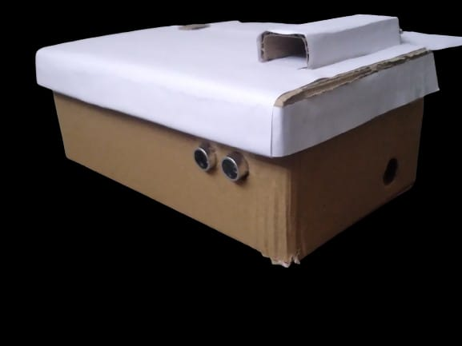
Smart Dustbin
Roll no :-
23911A1242
23911A1240
23911A1241
By:-
M Raghavendra ( IT – A )
M Yugnesh ( IT – A )
M Jyothika (IT - A)

Slide 2
Introduction to Smart Dustbin :-
The Smart Dustbin is an advanced waste management device. It uses sensor technology for hands-free operation, automatically opening and closing its lid when it detects trash or a hand near it. This not only makes waste disposal more convenient but also promotes hygiene and a cleaner environment. The Smart Dustbin is a step towards smarter, more responsible waste management.

Slide 3
Key Components :-
Arduino Nano
The brain of the smart dustbin, the Arduino Nano, is a compact and powerful microcontroller that enables precise control and coordination of the bin's various functions.
Ultrasonic Sensor
The ultrasonic sensor detects the waste or hand or object near it. triggering the automatic lid opening and closing mechanism for a seamless user experience.
Servo Motor
The servo motor is responsible for the smooth and precise operation of the bin's lid, ensuring a reliable and hassle-free waste disposal process.

Slide 4
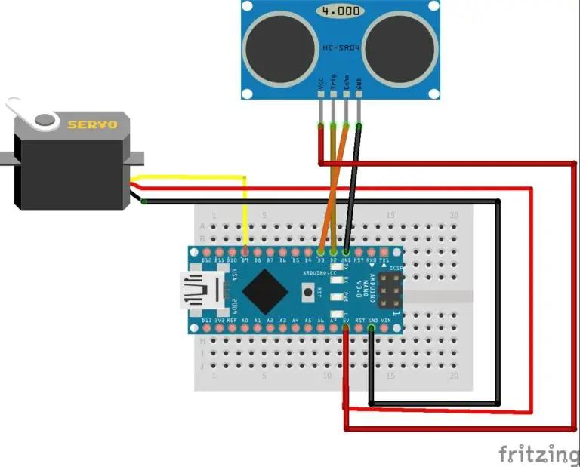
Circuit Diagram :-

Slide 5
Functionality :-
Presence Detection
The ultrasonic sensor is a key component of the Smart Dustbin. It operates continuously, vigilantly scanning for waste. Upon detecting waste within its range, it triggers the automatic opening of the lid, ensuring a seamless and hygienic waste disposal experience. This advanced functionality underscores the efficiency and convenience of the Smart Dustbin.
Lid Opening
The servo motor lifts the lid, allowing for convenient waste disposal.
Lid Closing
After a brief delay, the lid automatically closes to maintain hygiene

Slide 6
Benefits and Applications :-
Hands-free Operation
Energy Efficiency
Eliminates the need to touch the dustbin, promoting cleanliness and reducing the spread of germs.
The smart dustbin only opens the lid when needed, conserving energy and reducing wast.
Versatile Design
Environmentally Friendly
Can be used in homes, offices, and public spaces to streamline waste management.
Contributes to sustainability by reducing waste and promoting proper waste disposal.

Slide 7
Source Code :-
void measureDistance()
{
digitalWrite(trigPin, LOW);
delayMicroseconds(5);
digitalWrite(trigPin, HIGH);
delayMicroseconds(15);
digitalWrite(trigPin, LOW);
duration = pulseIn(echoPin, HIGH);
distance = (duration / 2) / 29.1; // Calculate distance
} void loop() {
measureDistance(); // Measure distance
if (distance < 8)
{
servoMotor.attach(servoPin);
delay(1);
servoMotor.write(80); // Open the lid
delay(4000); // Wait for 4 seconds
servoMotor.write(170); // Close the lid
delay(4000);
servoMotor.detach(); // Detach the servo
}
delay(50); // Delay between measurements
}
#include <Servo.h> // Include servo library
Servo servoMotor;
int trigPin = 2;
int echoPin = 3;
int servoPin = 9;
long duration, distance;
void setup() {
servoMotor.attach(servoPin);
pinMode(trigPin, OUTPUT);
pinMode(echoPin, INPUT);
servoMotor.write(10); // Close lid on power on
delay(2000);
servoMotor.detach();
}

Slide 8
Thank You

